Slide 1
NeuroFleetX - AI-Driven Urban Mobility Optimization
Infosys spring board Internship 6.0
presented By
HARIPRIYA
.

Slide 2
INTRODUCTION
NeuroFleetX is an AI-driven platform that optimizes fleet operations through real-time monitoring, predictive analytics, and automated decision-making, enhancing efficiency, safety, and cost-effectiveness.
NeuroFleetX is a modern, AI-powered fleet management and autonomous vehicle dispatching system built with a Spring Boot backend and React + TypeScript frontend. The platform enables real-time vehicle tracking, intelligent booking management, predictive maintenance, emergency response coordination, and system health monitoring for autonomous fleets.
overview
NeuroFleetX is an AI-driven platform that optimizes fleet operations through real-time monitoring, predictive analytics, and automated decision-making, enhancing efficiency, safety, and cost-effectiveness.

Slide 3
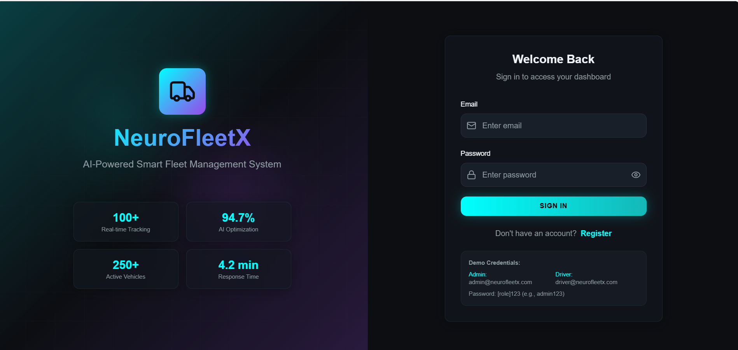
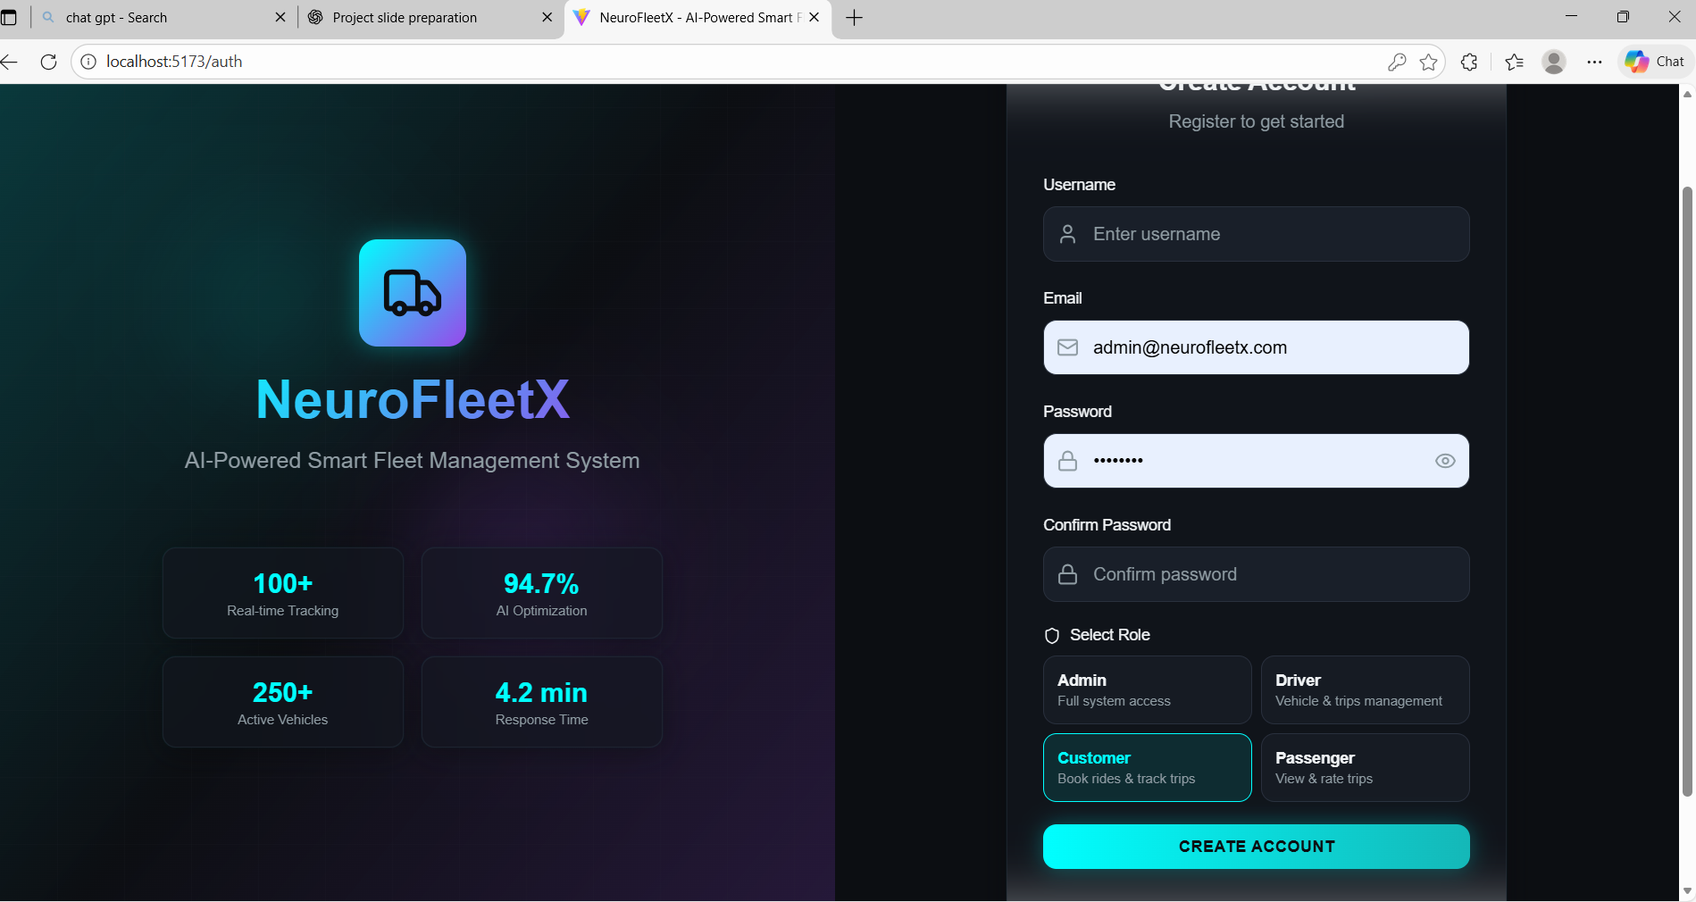
Authentication and Role Management
Implements multi-factor authentication and role-based access control to ensure secure access. Employs end-to-end encryption and strict data governance to protect user privacy and safeguard sensitive fleet information.
JWT-based authentication mechanisms
JWT-based authentication ensures secure, stateless user verification by encoding user credentials in digitally signed tokens, enabling efficient authorization and reducing server load without compromising security.
Role-based access control
Role-based access control (RBAC) ensures secure authentication and authorization by assigning permissions based on user roles, minimizing risks and enhancing data protection within the NeuroFleetX system.
Data protection and privacy
Implements multi-factor authentication and role-based access control to ensure secure access. Employs end-to-end encryption and strict data governance to protect user privacy and safeguard sensitive fleet information.

Slide 4
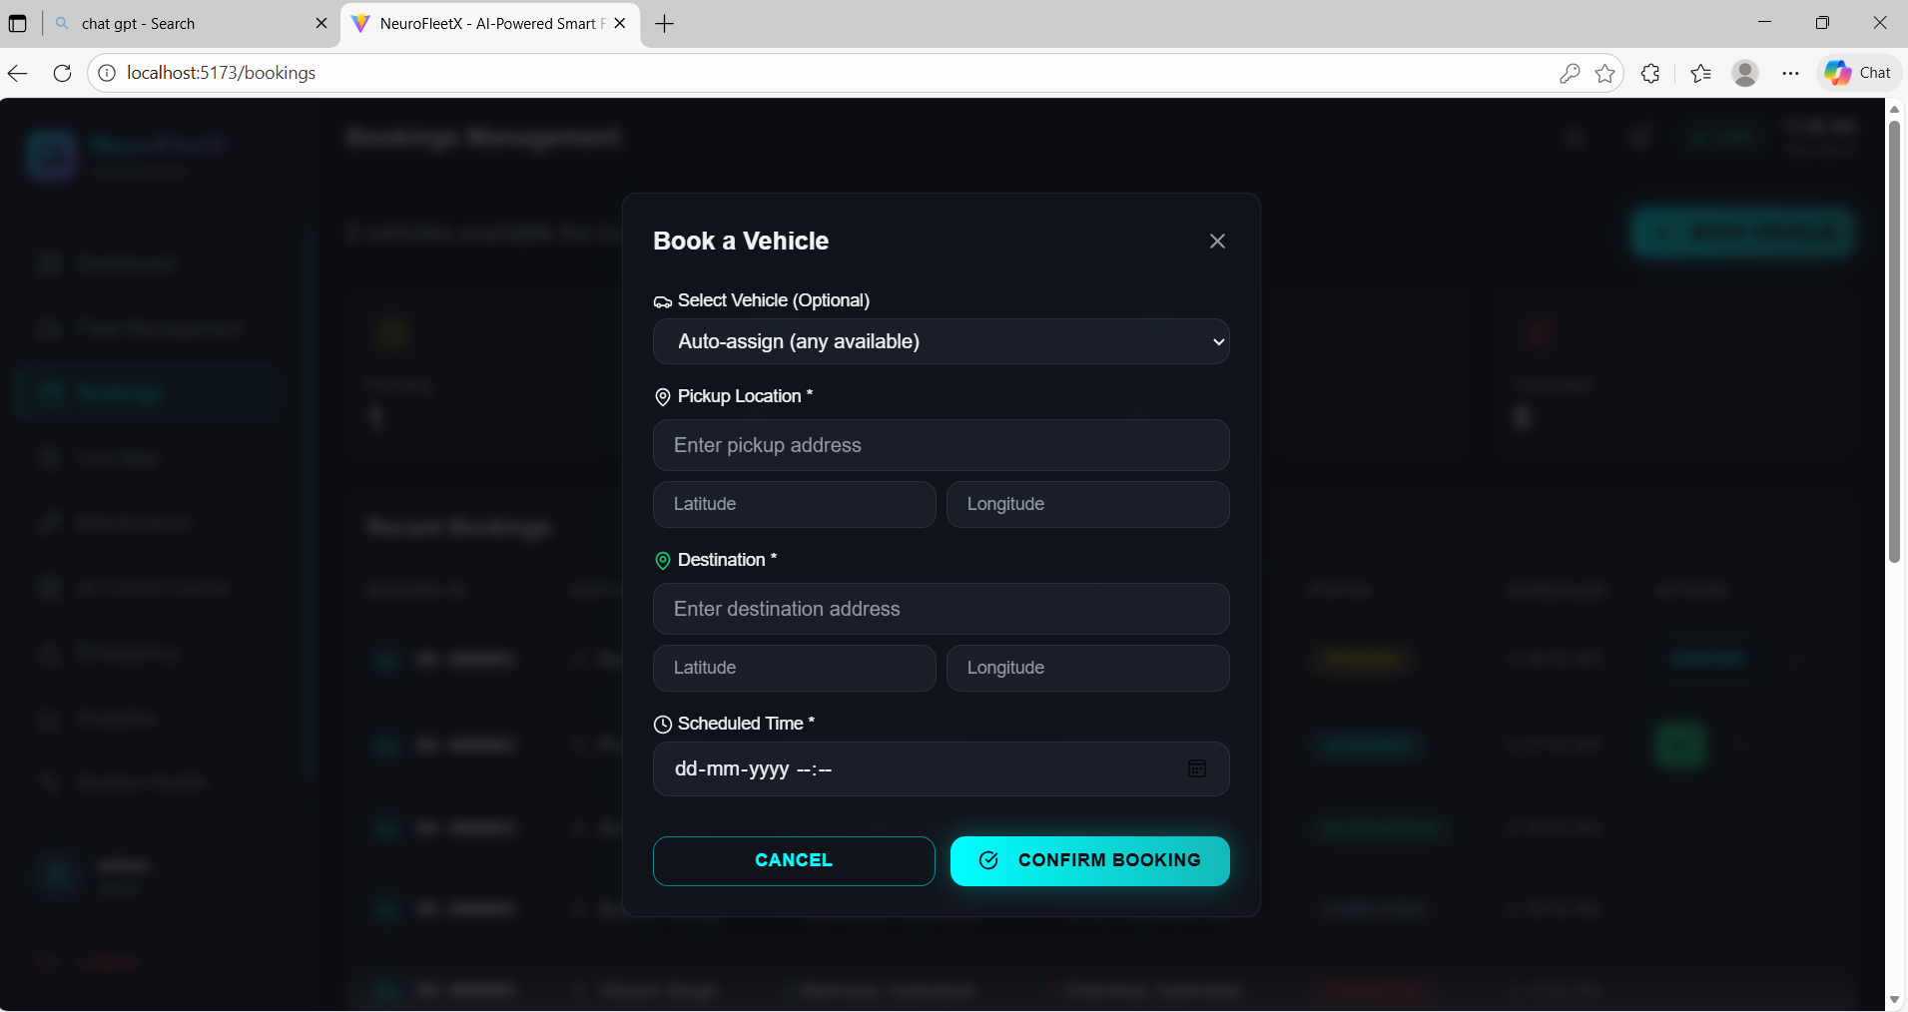
Fleet Inventory and Vehicle Telemetry
NeuroFleetX serves admins, drivers, customers, and emergency services, providing AI-driven fleet oversight, real-time communication, enhanced safety, and efficient incident response for optimized fleet operations.
NeuroFleetX serves admins, drivers, customers, and emergency services, providing AI-driven fleet oversight, real-time communication, enhanced safety, and efficient incident response for optimized fleet operations.
The system stores the full fleet inventory, including each vehicle’s model, license details, operational status, and overall health. It enables real-time GPS tracking using latitude and longitude coordinates, allowing continuous visibility of vehicle movement..
Target users: Admins, drivers, customers, emergency services
NeuroFleetX serves admins, drivers, customers, and emergency services, providing AI-driven fleet oversight, real-time communication, enhanced safety, and efficient incident response for optimized fleet operations.
Key highlights overview
NeuroFleetX integrates AI to optimize fleet operations, enhancing efficiency, reducing costs, improving safety, and providing real-time data insights for smarter decision-making and seamless management.

Slide 5
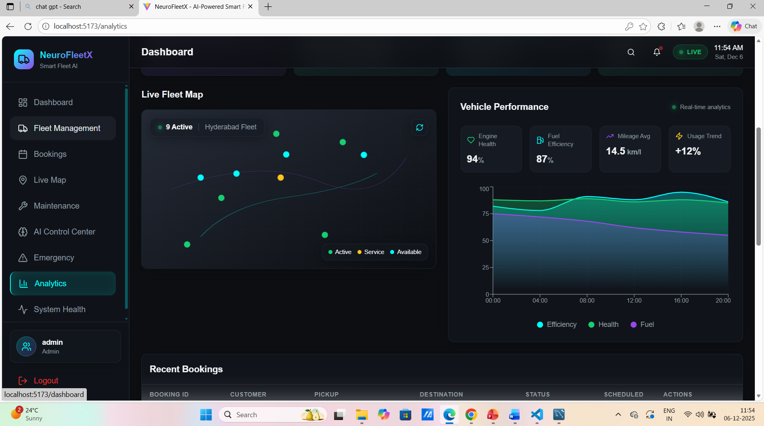
AI Route and Load Optimization Engine
Leverages predictive analytics to forecast fleet performance, enabling proactive maintenance scheduling, route optimization, and resource allocation for enhanced operational efficiency and reduced downtime.
Enhancing fuel efficiency and operations
Climate-aware tropical optimization
Smart route recommendation for faster trips
Load balancing across vehicle fleet
Predicts demand peaks and optimizes resource allocation
Reduces operational cost & improves mobility efficiency
Leverages AI to optimize routes and driving behavior, reducing fuel consumption and operational costs while enhancing overall fleet efficiency and sustainability through predictive analytics and real-time performance monitoring.
Leverages predictive analytics to forecast fleet performance, enabling proactive maintenance scheduling, route optimization, and resource allocation for enhanced operational efficiency and reduced downtime.
Data analytics on routes and traffic flow
Analyzes route efficiency and traffic patterns using AI to optimize fleet scheduling, reduce delays, and enhance fuel economy, ensuring improved overall system performance and cost savings.

Slide 6
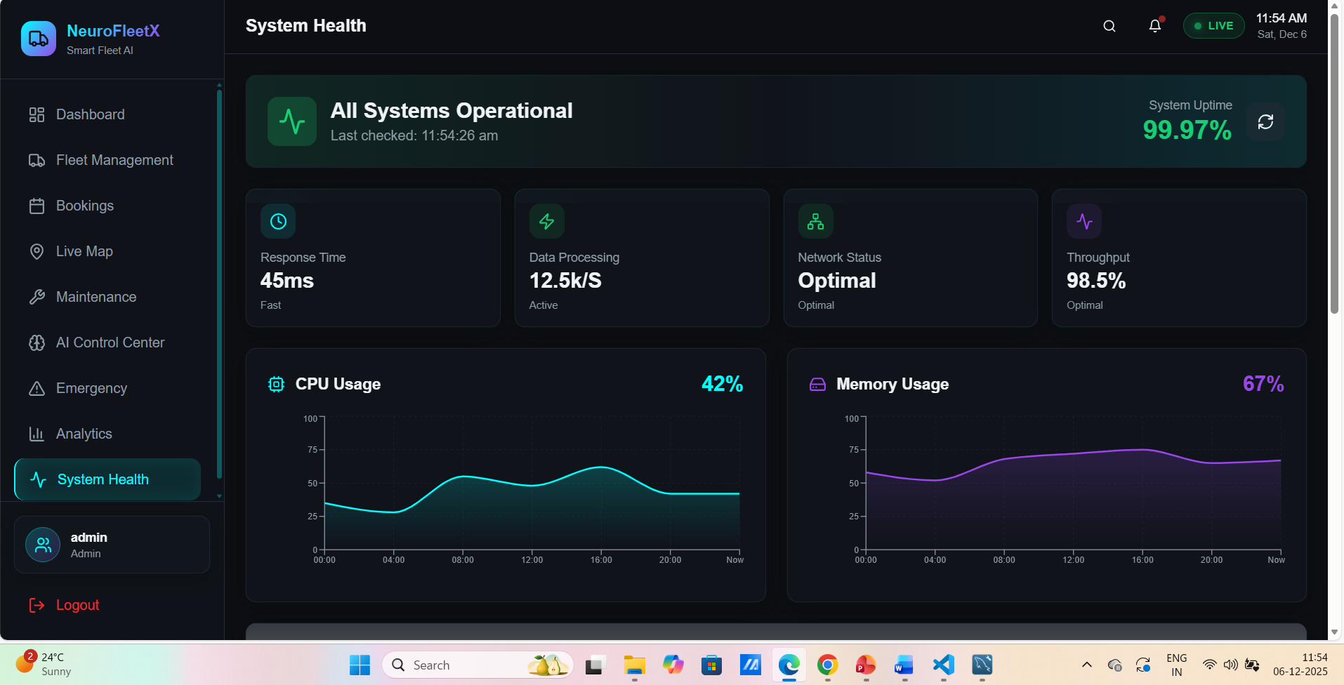
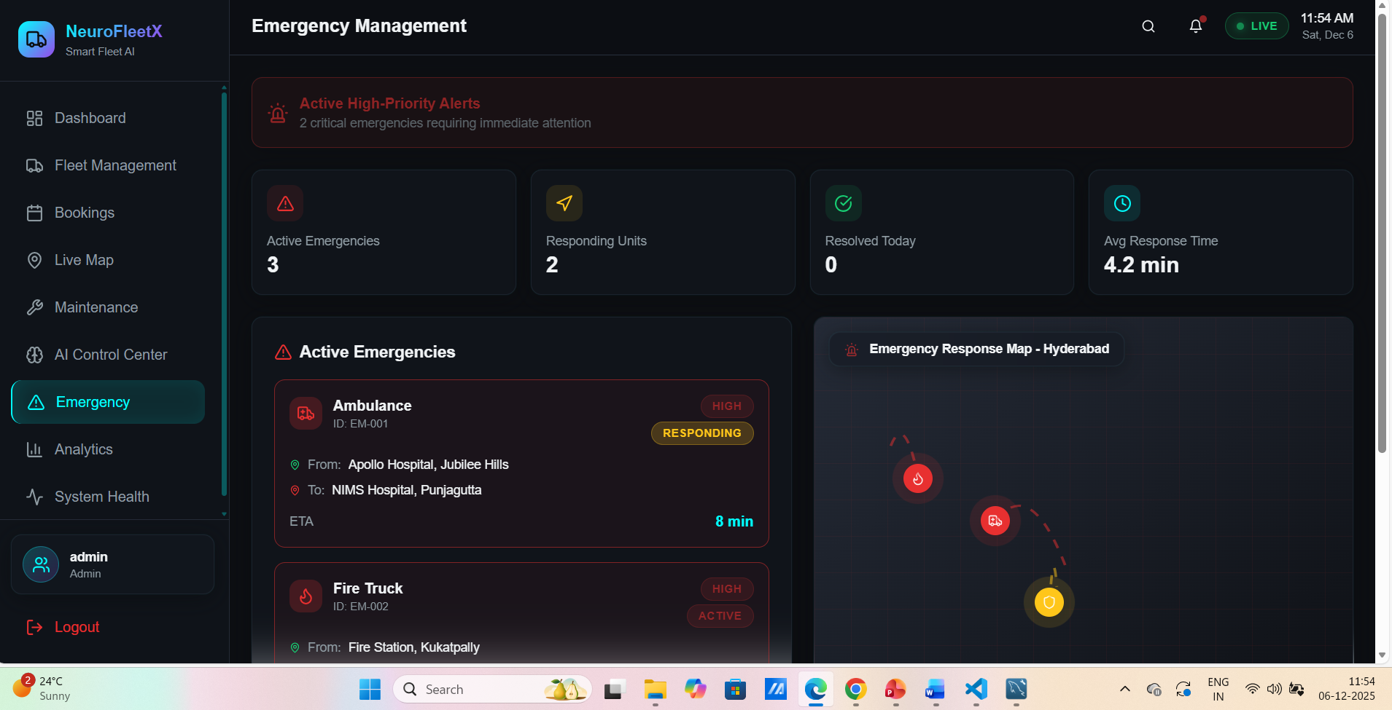
Predictive Maintenance and Health Analysis
The system uses real-time telemetry data to detect early warning signals and identify potential issues before they escalate. It efficiently tracks all forms of maintenance, including scheduled servicing, emergency repairs, and predictive maintenance based on vehicle performance trends. By proactively addressing faults, the platform helps prevent unexpected breakdowns and ensures smoother fleet operations. It also provides accurate maintenance cost estimation, enabling better budgeting and resource planning. Overall, this approach significantly improves fleet reliability, reduces downtime, and extends the service life of vehicles.

Slide 7
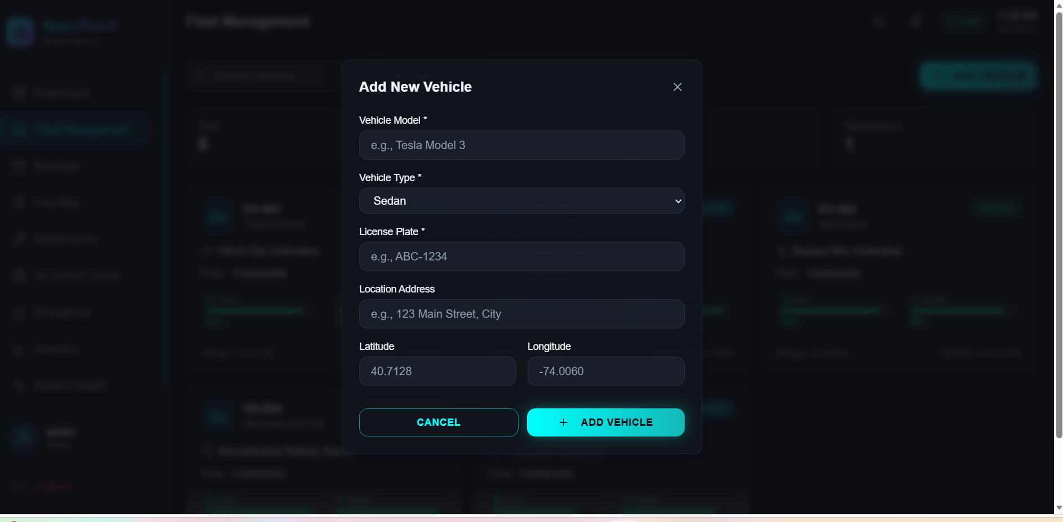
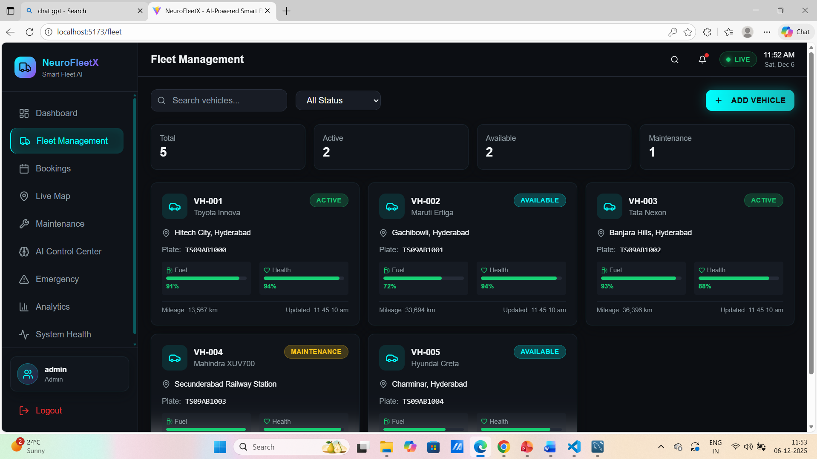
Customer Booking and Smart Recommendations
User-friendly ride booking (pickup → destination)
Intelligent matching of best vehicle-driver pair
Real-time booking updates (Pending → Completed)
Auto fare calculation & rating system
Personalized ride suggestions & route recommendations

Slide 8
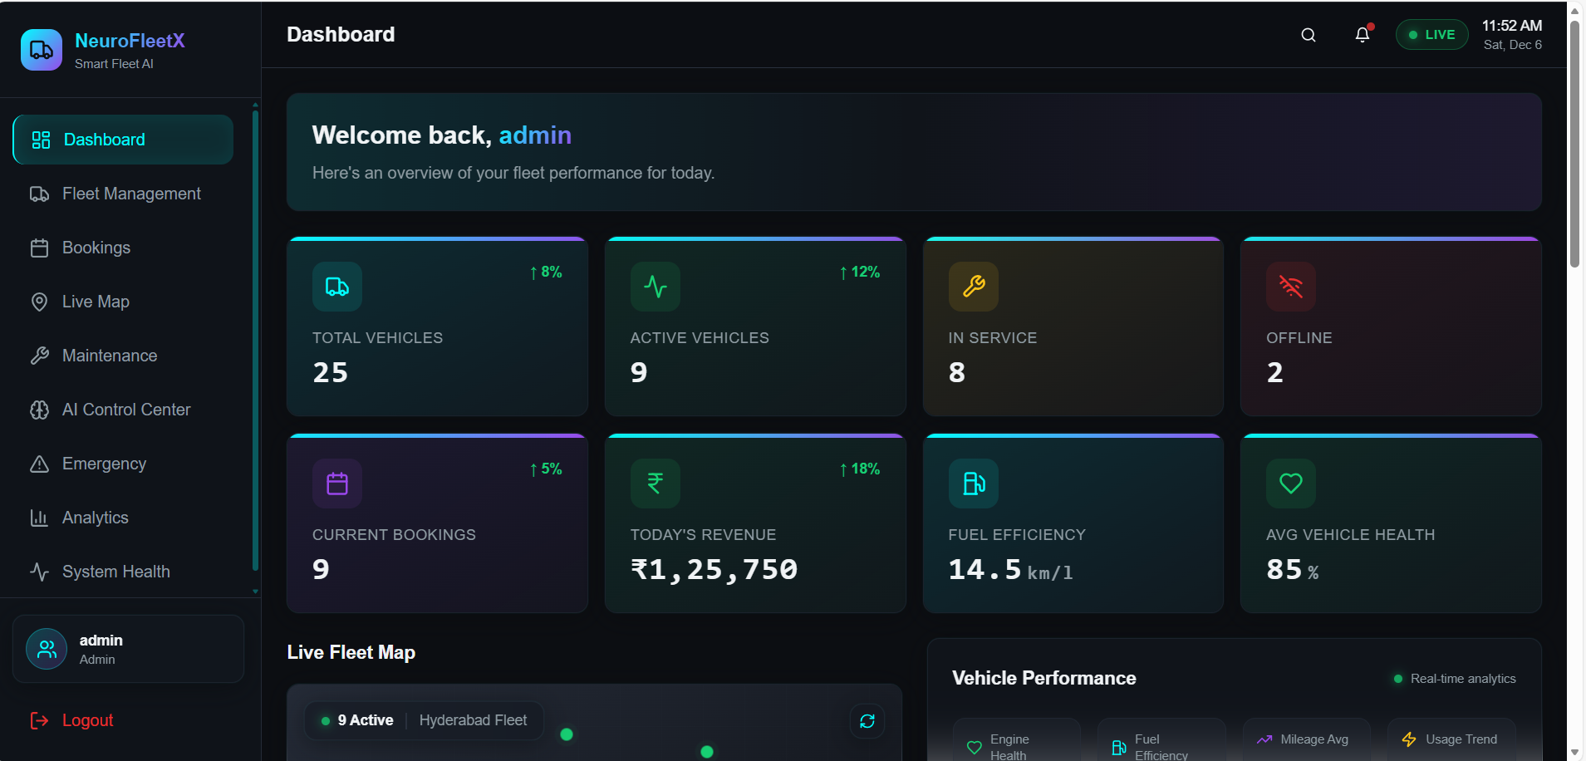
Admin Dashboard and Urban Mobility Insights
Displays KPIs: total vehicles, revenue, bookings, ratings
Shows fleet availability and system health metrics
Monitors CPU, memory, network & DB status
AI-driven analytics for traffic patterns & fleet usage
Helps admins make informed decisions
Spring Boot backend overview
Spring Boot backend provides a robust, scalable RESTful API architecture, enabling rapid development with embedded servers, seamless integration, and enhanced security features for efficient fleet data management.
React + TypeScript frontend features
React with TypeScript enhances NeuroFleetX’s frontend by enabling type safety, scalable component architecture, and improved developer productivity, ensuring robust, maintainable, and high-performance user interfaces.

Slide 9
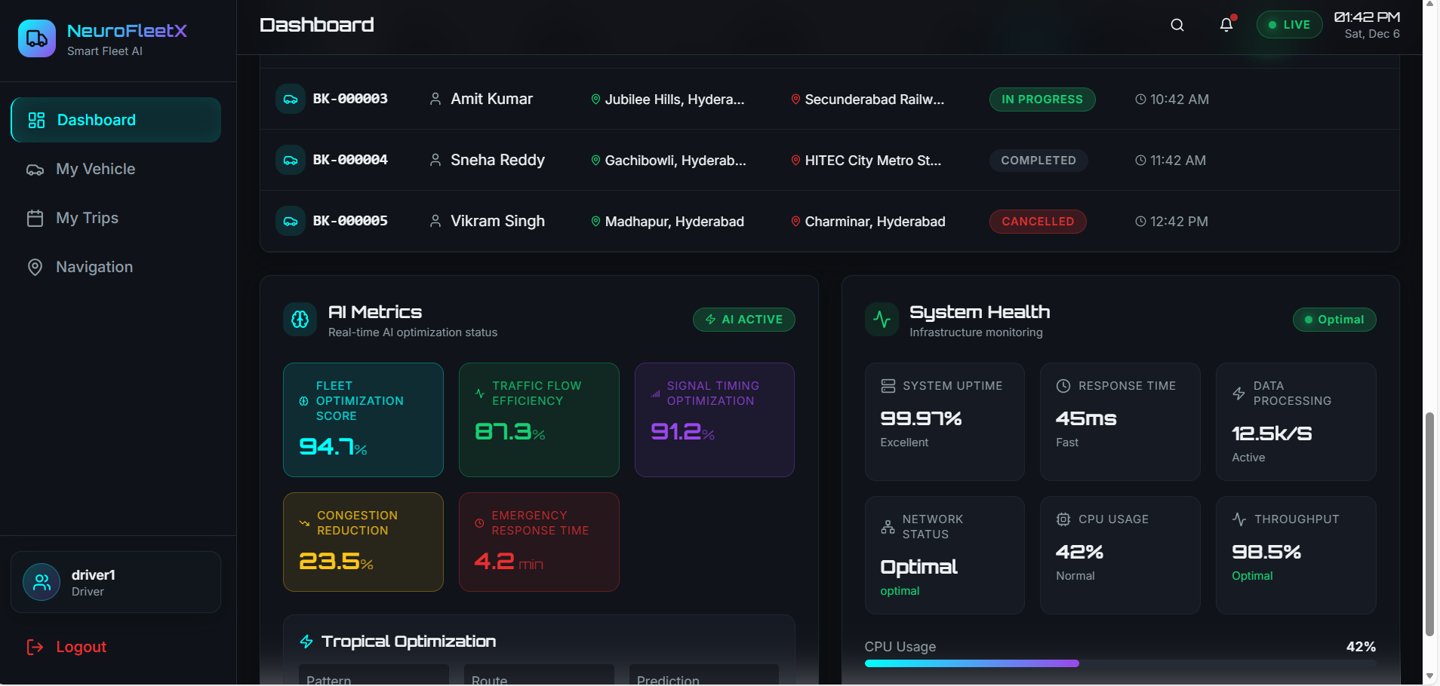
Conclusion
NeuroFleetX provides a unified and intelligent solution for complete fleet automation, bringing together AI-driven decision-making, real-time telemetry monitoring, smart booking workflows, and robust security mechanisms. By seamlessly integrating these components, the platform ensures greater operational efficiency, enhanced safety, and high-performance fleet management. Designed as a scalable and future-ready system, NeuroFleetX supports the evolving needs of modern autonomous mobility and delivers a reliable foundation for advanced transportation networks.

Slide 10
Thank you

